Slide 1

2k24
GENESIS
ACES
....Guiding Dreams, flourishing success
PATH TO PO:
A RESUME TRANSFORMATION WORKSHOP
Cracking the Code to Professional Success

Slide 2

Nisarg Kudgunti
Introduction
B.E. Computer (2024 Expected)
ML Enthusiast || Published Writer || TEDxPVGCOET Licensee || Winner of Hackathon 2k21 || Microsoft Learn Student Ambassador

Slide 4



Slide 5

Humiliation

Slide 6
I was supposed to be the Dragon Warrior

Slide 7


But this dumb Panda took away my Position...

Slide 8
MY DESTINYYY!!!!!!

Slide 9

Tai Lung
PERSONAL INFORMATION
Nationality: Chinese
Email address:tailung@thebest.com
PROFILE
To obtain the esteemed position of Dragon Warrior and showcase my unparalleled kung fu skills for the benefit of the Valley of Peace.
WORK EXPERIENCE
Kung Fu Training Academy
Completed extensive training in various martial arts disciplines. Studied under the guidance of the revered Master Shifu.
SKILLS
Martial Arts Expertise Professional
Mental Focus Professional

Slide 10

Need your help ...

Slide 11

Po v/s Tai Lung

Slide 12



What is a Resume?
A document where you share important information about yourself
Usually a job application requirement
A resume is like a highlight reel of your professional life.
Tells the employer why you are a great fit for the job

Slide 13

How to Start?
Conduct Research
Review Job Description
Meet with Industry People
Review resume samples
Get Feedback

Slide 14
Why Use LaTeX for Your Resume?
LaTex
01
Looks Super Professional
A super-smart tool for making your resume look really cool.
Also, used in journal articles, technical reports, books.
It is Applicant Tracking System (ATS) Friendly.
02
No Formatting Headaches
03
Easy to Update
04
Way more control and flexibility
05
Markup Language familiar to HTML

Slide 15
01
Single Page Rule
Resume Layout Best Practices
02
Use Action Verbs
03
Clearly Defined Sections
04
Consistent Formatting
05
Maintain sufficient white space.
06
Reverse Chronological Rule

Slide 16
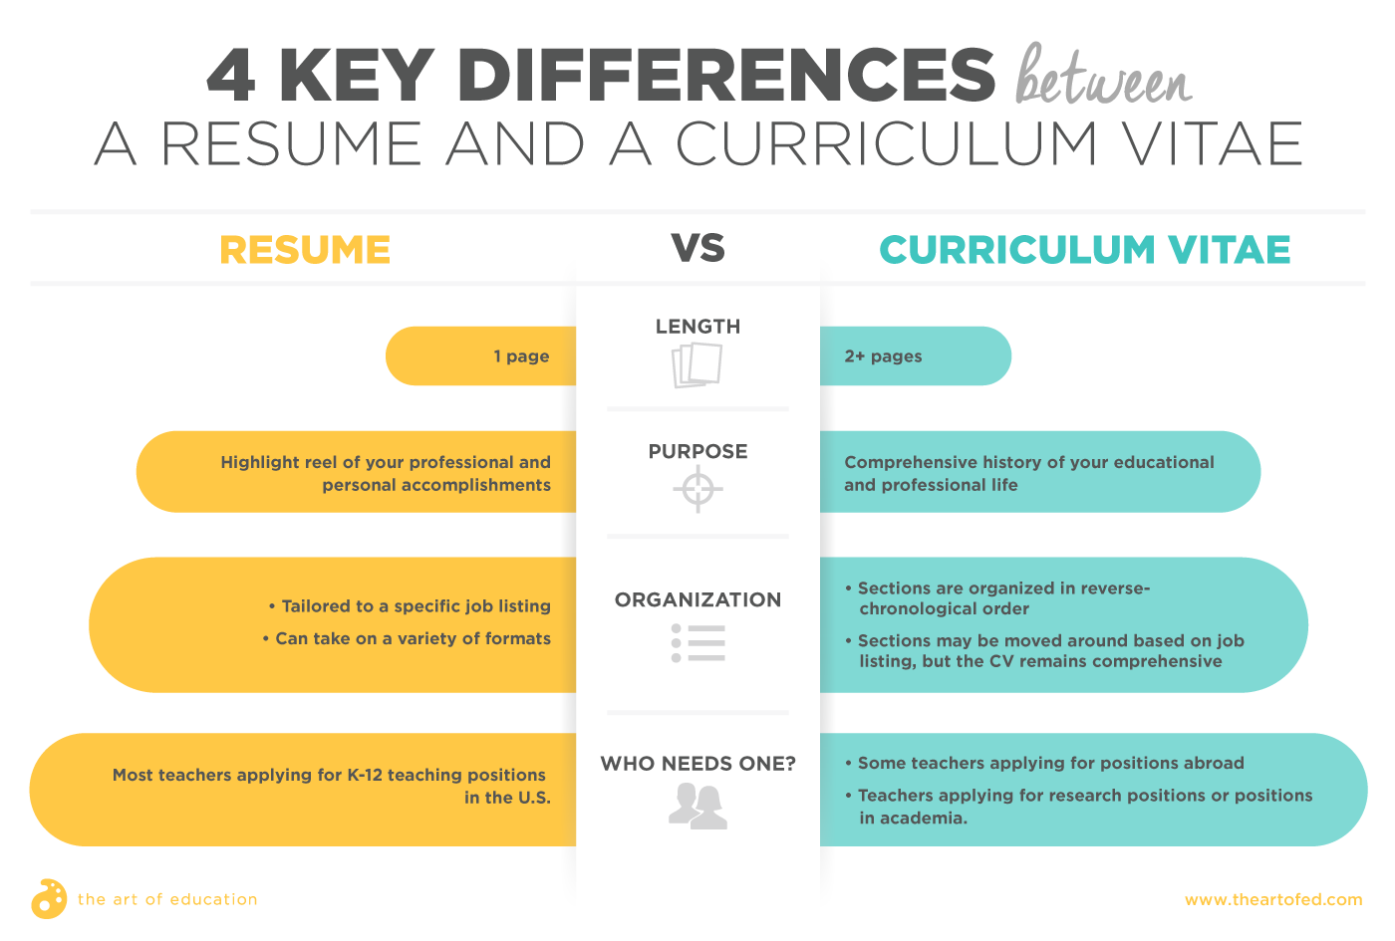

Slide 17
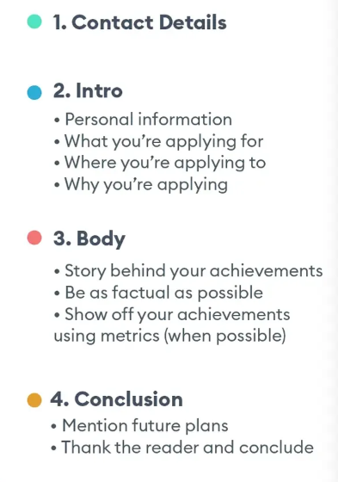
Cover Letter
A cover letter is a supplement to your resume, not a replacement.
Don’t repeat whatever is mentioned in your resume.
Not always mandatory.
Paragraph 1: Why You Are a Good Fit
Paragraph 3: Company Knowledge
Paragraph 2: Relevant Experience
Paragraph 4: Closing Statement

Slide 18

That's a wrap!
Any Questions?
Jan 17, 2024

